Slide 1
Chapter One
Introduction to Hardware, software, and The development environment

Slide 2
Hardware

Slide 3
Computer Hardware
Hardware consists of the physical elements in a computer system.
Some very visible examples are the monitor, the mouse, external storage, and the keyboard.
The central processing unit (CPU) performs program control and data processing
Storage devices include
Memory (RAM)
Secondary storage: hard disk, flash drives, CD/DVD drives…
Input / output devices allow the user to interact with the computer:
Mouse, keyboard, printer, screen…

Slide 4
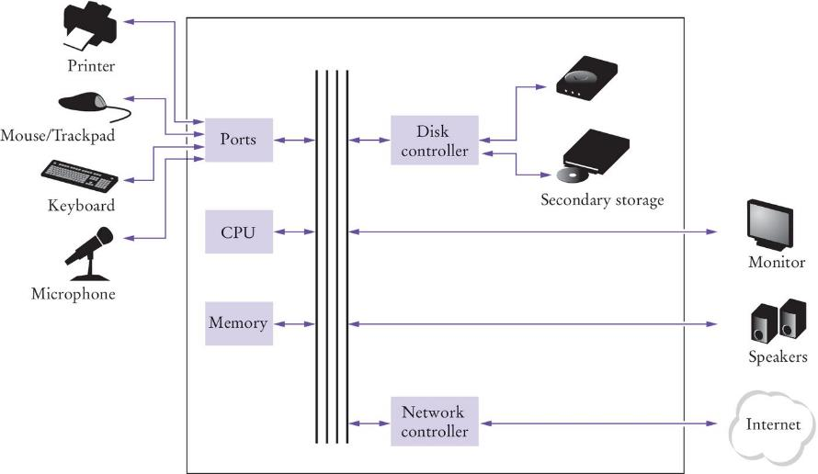
Basic Hardware Components

Slide 5
The CPU
The CPU has two components, the control unit and the arithmetic logic unit
The control unit directs operation of the processor.
All computer resources are managed by the control unit.
It controls communication and co-ordination between input/output devices.
It reads and interprets instructions and determines the sequence for processing the data.
It provides timing and control signals
The the arithmetic logic unit contains the circuitry to perform calculations and do comparisons.
It is the workhorse portion of the computer and its job is to do precisely what the control unit tells it to do.

Slide 6
Storage
There are two types of storage:
Primary Storage
Secondary Storage
Primary storage is composed of memory chips: electronic circuits that can store data as long as it is provided electric power.
Secondary storage is a slower, less expensive storage that is persistent: the data persists without electric power.
Computers store both data and code (programs).
The data and code are located in secondary storage and loaded into memory when the program is executed.

Slide 7
Memory
A simple way to envision primary memory is a table of cells all the same size (one byte), and each byte containing a unique address, beginning with address 0.
The “typical” computer has a main memory ranging from 4 gigabytes to 32 gigabyte.
How big is a gigabyte?
A byte is 8 bits, each bit contains a 1 or 0 value.
A kilobyte, KB, is 1024 bytes, or “about 1 thousand bytes.”
A megabyte, MB, is 1,048,576 bytes, or “about 1 million bytes.”
A gigabyte, GB, is 1,073,741,824 bytes or “about 1 billion bytes.”
Notes:
Remember BINAC had a 512 WORD (31 bits per word) main memory

Slide 8
Executing a Program on the Hardware
Program instructions and data are stored in secondary storage in binary format.
When a program is started, it is copied into main memory, where the CPU can read it.
The CPU runs the program one instruction at a time.
The program may react to input from the user or from an IO device.
The program may produce output, which goes to an IO device.
The instructions and program input guide the program execution.
The CPU reads input data, modifies it, and writes the result back to memory, the screen, or secondary storage.

Slide 9
Software

Slide 10
Software
Software is typically realized as an application program, but operating systems and device drivers are also software.
Software is a sequence of instructions and decisions implemented in some programming language and translated to a form that can be executed or run on the computer.
Computers execute very basic instructions in rapid succession. The basic instructions together can perform complex tasks.
Programming is the act of designing and implementing computer programs.

Slide 11
Algorithms
An algorithm is a step by step description of how to solve a problem.
For complex problems software developers write an algorithm before they attempt to write the program to implement the algorithm.
Developing algorithms is a fundamental problem solving skill. It has uses in many fields outside of Computer Science.

Slide 12
The Python Programming Language

Slide 13
The Python Language
In the early 1990s, Guido van Rossum designed what would become the Python programming language.
Python was designed to have a simpler and cleaner syntax than other popular languages such as Java, C and C++.
Python programs are executed by the Python interpreter. The interpreter reads each line of code in a program and executes it.

Slide 14
Python Programming Environment
There are several ways of creating a Python program or Python script:
Using an Integrated Development Environment (IDE)
Using a text editor
For this class we will use the Wing IDE, but you can use any IDE or text editor that you’re comfortable with.
The IDE provides a text editor, output window, as well as debugging tools.
Python code can also be run at the Python shell in interactive mode. The Python shell is useful to test snippets of code before incorporating them into a program.
The Python shell prompt is: >>>
When using the shell, enter a Python statement at the shell and the output of the statement will appear in the next line(s).
A Python shell that comes with Python is IDLE. When we use the Wing IDE, it also comes with a Python shell.

Slide 15
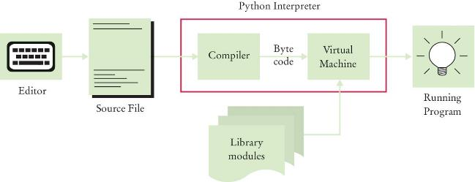
From Source Code to Executable
The compiler reads a source file and generates byte code instructions (simple instructions for the Python Virtual machine).
The Python Virtual machine is a program that is similar to the CPU of our computer.
Any necessary libraries (e.g. for drawing graphics) are automatically located and included by the virtual machine

Slide 16
Analyzing The First Python Program
A Python program contains one or more lines of instructions (statements) that will be translated and executed by the interpreter.
The first line is a comment (a statement that provides descriptive information about the program to a human reader).
The second line contains a statement that prints a line of text on screen: Hello, World!
# My first Python program
print(“Hello World!”)

Slide 17
A Python Program

Slide 18
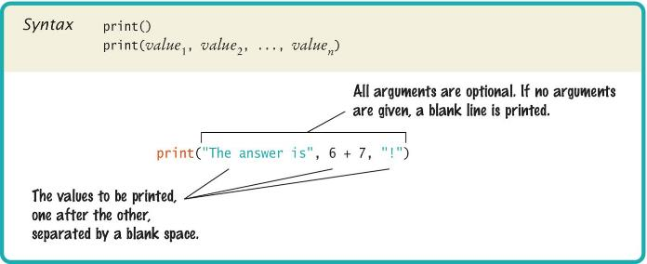
Basic Python Syntax: print
Use the print function to print text and data values to screen.
A function is a collection of programming instructions that carry out a particular task (in this case to print a value onscreen).
A function is code that someone else wrote for us to use.

Slide 19
Syntax for Python Functions
To use, or call, a function we need to specify:
The name of the function (Example: print is the name of the function
Input data (arguments) needed by the function to carry out its task (Example: the string “Hello World!”).
Arguments are enclosed in parentheses and multiple arguments are separated with commas.
A sequence of characters enclosed in quotations marks are called a string.

Slide 20
More Examples of the print Function
Printing numerical values from an expression:
Printing multiple, comma separated values:
Each value passed to the function is displayed, one after another, with a blank space after each value.
By default print starts a new line after it prints all input values.
print(3 + 4) # evaluate expression to 7 and print: 7
print(“the answer is”, 6 * 7) # print: The answer is 7
print(“Hello there”) # print: Hello there
print(“world”) # print: world
# one output line for each print

Slide 21
Errors
There are two categories of errors:
Compile-time errors or syntax errors
Spelling, capitalization, punctuation, indentation
Ordering of statements, matching of parentheses, quotes…
Program will not run to completion until all errors are fixed
Run-time errors
The program runs but produces unintended results
The program may ‘crash’ (end abruptly with error messages)

Slide 22
Program Errors

Slide 23
Syntax Errors
Syntax error are caught by the Python interpreter
What happens if we
Use the wrong case print("Hello World!")
Leave out quotes print(Hello World!)
Mismatch quotes print("Hello World!')
Mismatch brackets print('Hello'
When a syntax error is found by the Python interpreter, the error message will contain the line number of the line of code where the error is found.
We need to fix each error, one at a time, before the program can run completely from beginning to end.

Slide 24
Run-Time Errors
Run time errors occur when the code is running.
What happens if we
Divide by zero print(12/0)
Misspell output print("Hello, Worrd")
Forget to output no print statement
The program will compile and run but will not produce the expected output.
Sometime the output will be missing information or contain a wrong output value. In this case we need to re-evaluate the algorithm that we use to see where the logic error is.
Sometime the output will be an exception, which is an error message from the Python interpreter because a line of code cannot be run.
In this case the error message will show us the exception type and the line of code where the error occurs. We will need to go to the specified line of code to fix the error.

Slide 25
End of Chapter 1 Notes

